Slide 1
2024 Bayesian Modelling Workshop
Seungjae Lee
Department of Civil & Mineral Engineering
University of Toronto
July 30, 2024

Slide 2
Workshop Outline
Measurement uncertainty and Bayesian estimation
Bayesian linear regression
Latent/unobservable variables
Advanced Topics (if time allows):
Gaussian process regression
Bayesian optimization
Probabilistic deep learning

Slide 3
Linear Regression

Slide 4
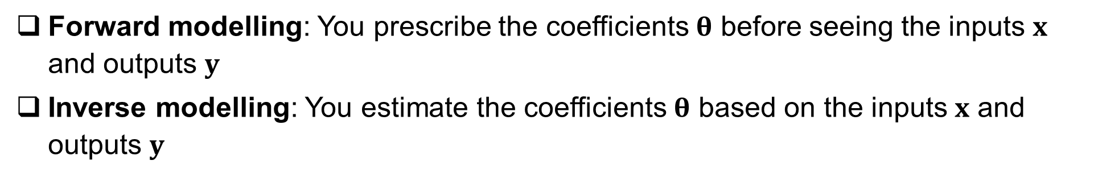
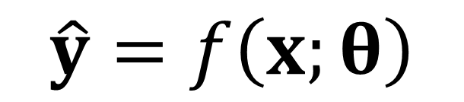
Forward vs Inverse Modelling
Functional form, Model structure/architecture
Inputs
Model coefficients
Predicted outputs
$$\hat{y}=f\left(x;θ\right)$$
Model
Forward modelling: You prescribe the coefficients $θ$ before seeing the inputs $x$ and outputs $y$
Inverse modelling: You estimate the coefficients $θ$ based on the inputs $x$ and outputs $y$

Slide 5
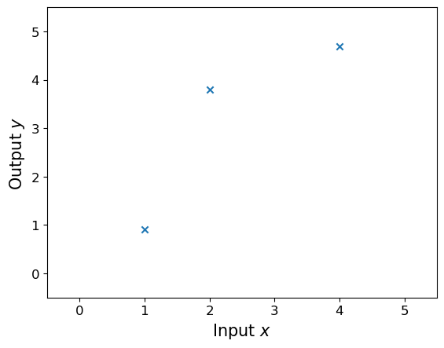
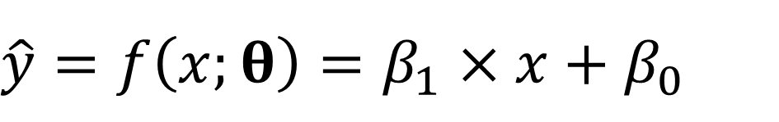
Linear Regression Review
$$\hat{y}=f\left(x;θ\right)=β_{1}×x+β_{0}$$

Slide 6
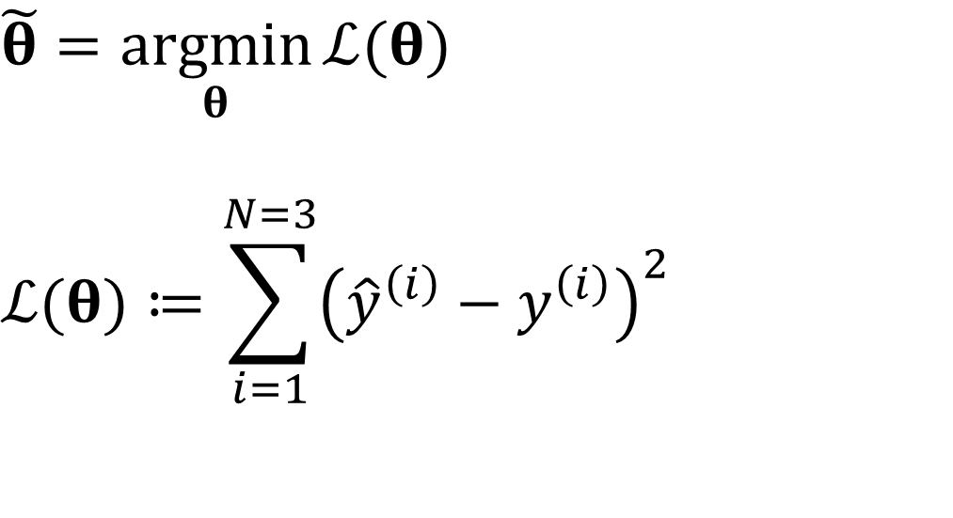
Linear Regression Review – Least Squares
$$\hat{y}=f\left(x;θ\right)=β_{1}×x+β_{0}$$
$$\tilde{θ}=\underset{θ}{argmin}{ℒ(θ)}$$
$$ℒ(θ)≔\sum_{i=1}^{N=3}{{\left({\hat{y}}^{\left(i\right)}−y^{\left(i\right)}\right)}^{2}}$$

Slide 7
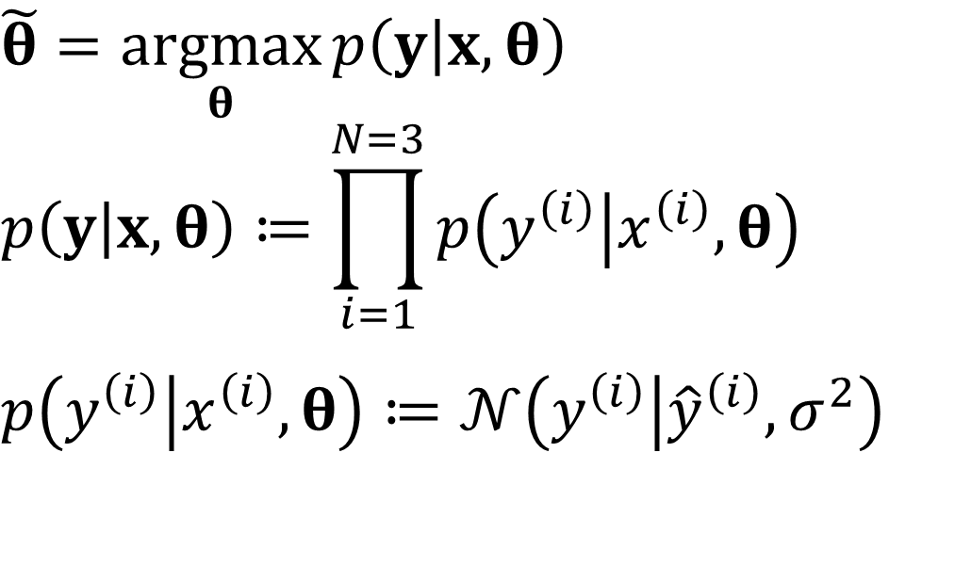
Linear Regression Review – Maximum Likelihood
$$\hat{y}=f\left(x;θ\right)=β_{1}×x+β_{0}$$
$$\tilde{θ}=\underset{θ}{argmax}{p\left(y | x,θ\right)}$$
$$p\left(y | x,θ\right)≔\prod_{i=1}^{N=3}{p\left(y^{\left(i\right)} | x^{\left(i\right)},θ\right)}$$
$$p\left(y^{\left(i\right)} | x^{\left(i\right)},θ\right)≔𝒩\left(y^{\left(i\right)} | {\hat{y}}^{\left(i\right)},σ^{2}\right)$$

Slide 8
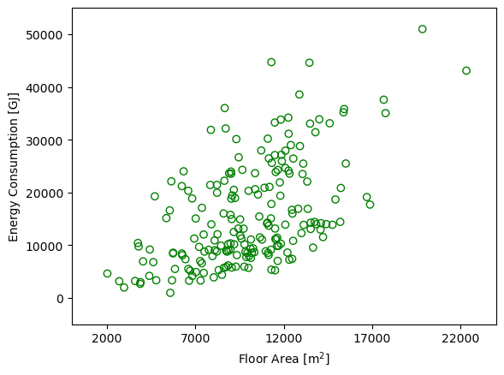
Linear Regression Review

Slide 9
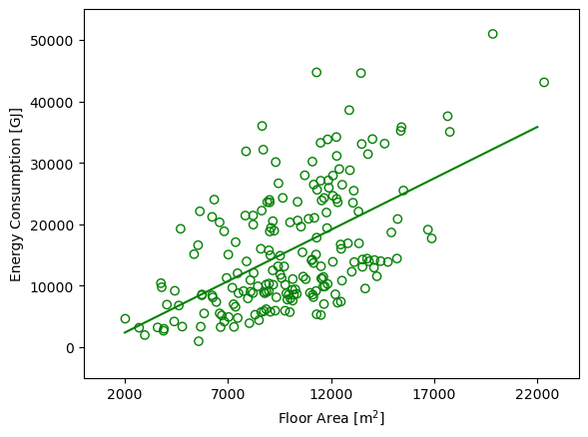
Linear Regression Review

Slide 10
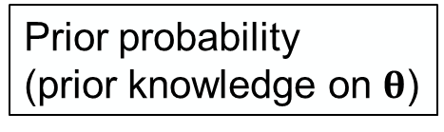
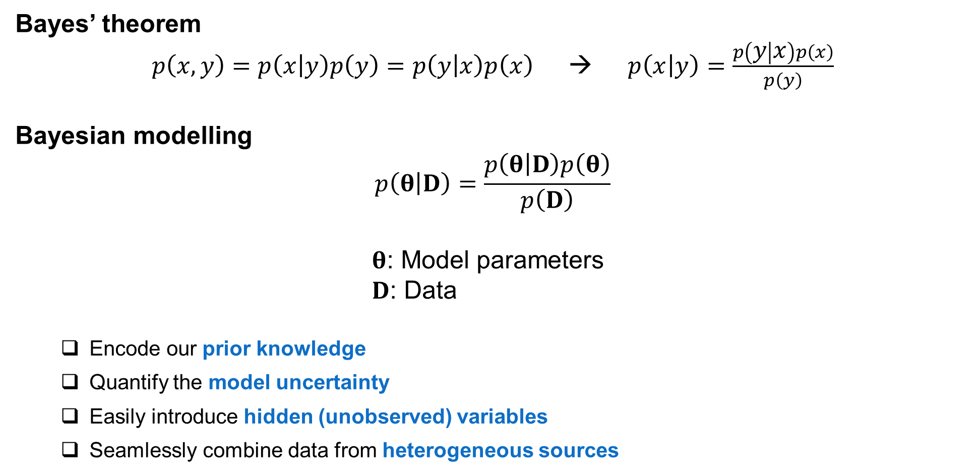
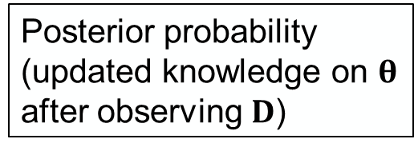
Bayesian Modelling
Bayes’ theorem
$p\left(x,y\right)=p\left(x | y\right)p\left(y\right)=p\left(y | x\right)p\left(x\right)$ → $p\left(x | y\right)=\frac{p\left(y | x\right)p\left(x\right)}{p\left(y\right)}$
Bayesian modelling
$$p\left(θ | D\right)=\frac{p\left(θ | D\right)p\left(θ\right)}{p\left(D\right)}$$
$θ$: Model parameters
$D$: Data
Encode our prior knowledge
Quantify the model uncertainty
Easily introduce hidden (unobserved) variables
Seamlessly combine data from heterogeneous sources
Likelihood
Prior probability
(prior knowledge on $θ$)
Posterior probability
(updated knowledge on $θ$ after observing $D$)
Flexible model structure

Slide 11
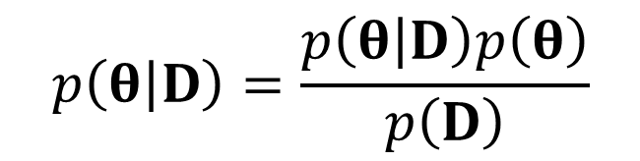
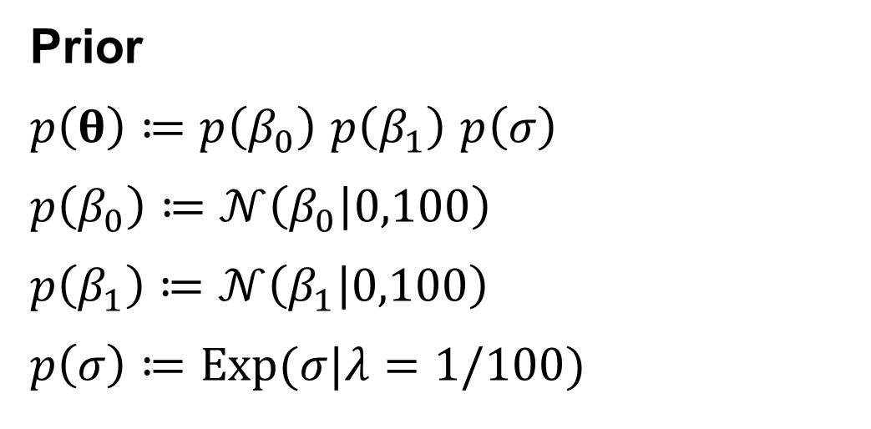
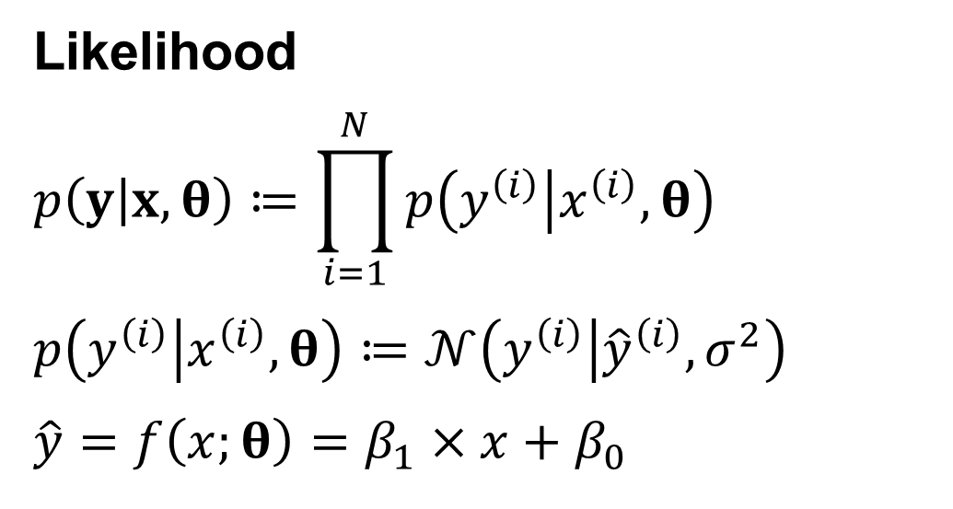


Bayesian Linear Regression
$$p\left(θ | D\right)=\frac{p\left(θ | D\right)p\left(θ\right)}{p\left(D\right)}$$
$$=\frac{p\left(θ | D\right)p\left(θ\right)}{\int{p\left(θ | D\right)p\left(θ\right)dθ}}$$
$$∝p\left(θ | D\right)p\left(θ\right)$$
Marginal likelihood (a.k.a., normalizing constant)
Prior
$p\left(θ\right)≔p\left(β_{0}\right)$ $p\left(β_{1}\right)$ $p\left(σ\right)$
$$p\left(β_{0}\right)≔𝒩\left(β_{0} | 0,100\right)$$
$$p\left(β_{1}\right)≔𝒩\left(β_{1} | 0,100\right)$$
$$p\left(σ\right)≔Exp(σ|λ=1/100)$$
Likelihood
$$p\left(y | x,θ\right)≔\prod_{i=1}^{N}{p\left(y^{\left(i\right)} | x^{\left(i\right)},θ\right)}$$
$$p\left(y^{\left(i\right)} | x^{\left(i\right)},θ\right)≔𝒩\left(y^{\left(i\right)} | {\hat{y}}^{\left(i\right)},σ^{2}\right)$$
$$\hat{y}=f\left(x;θ\right)=β_{1}×x+β_{0}$$

Slide 12
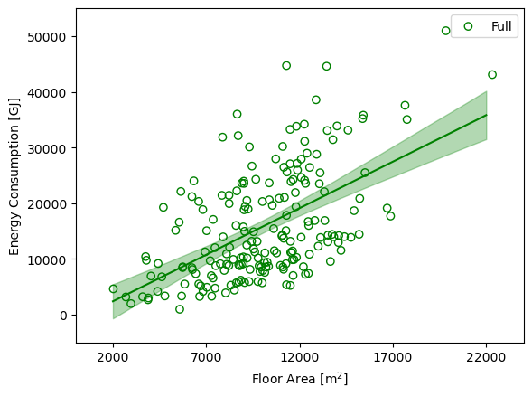
Bayesian Linear Regression
Least Squares (maximum-likelihood)
Bayesian

Slide 13
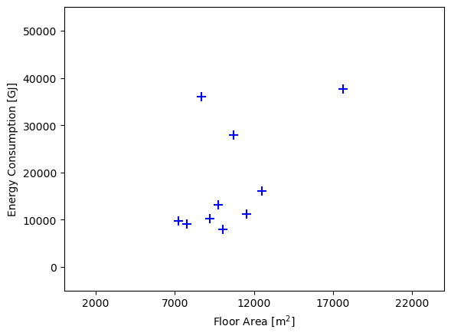
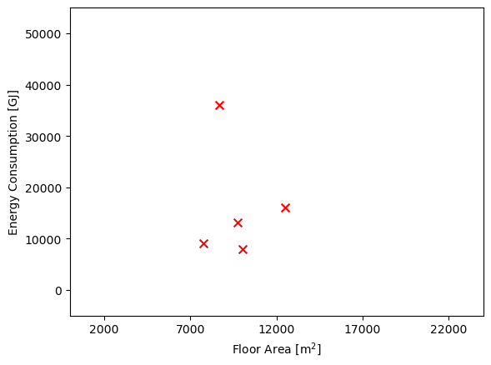
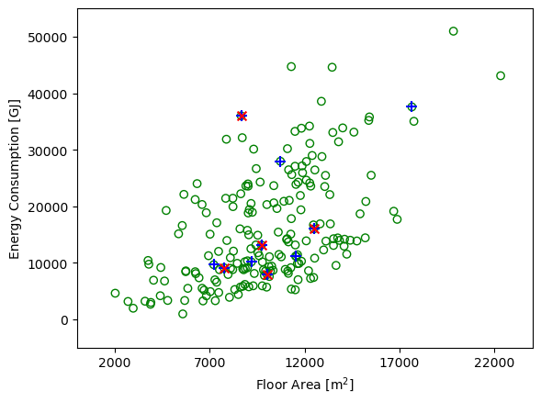
Bayesian Linear Regression
Full dataset
Subset
Subsubset

Slide 14
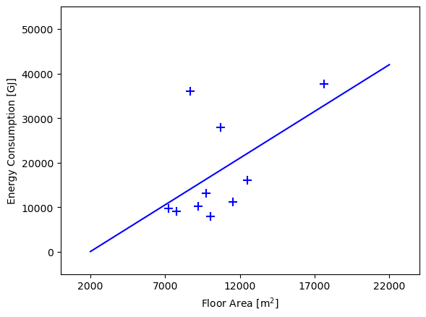
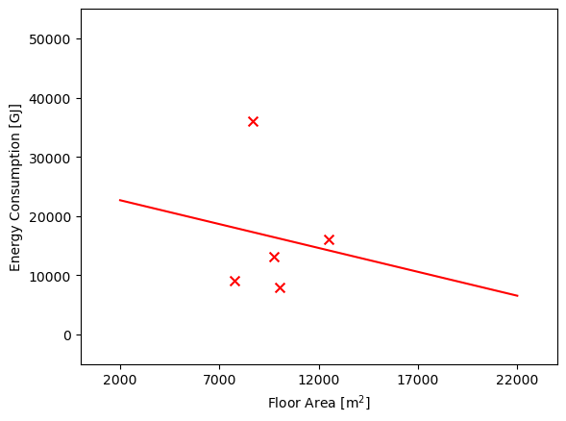
Bayesian Linear Regression
Full dataset
Subset
Subsubset

Slide 15
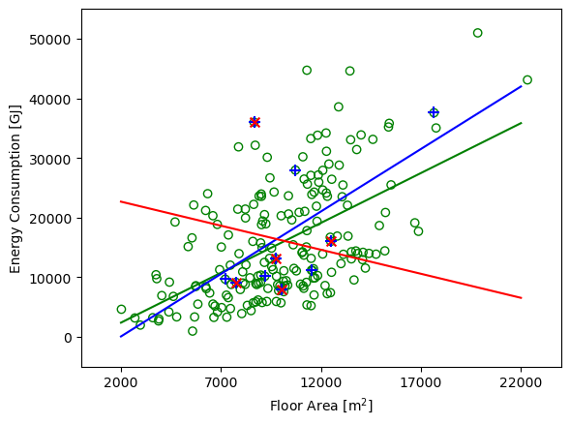
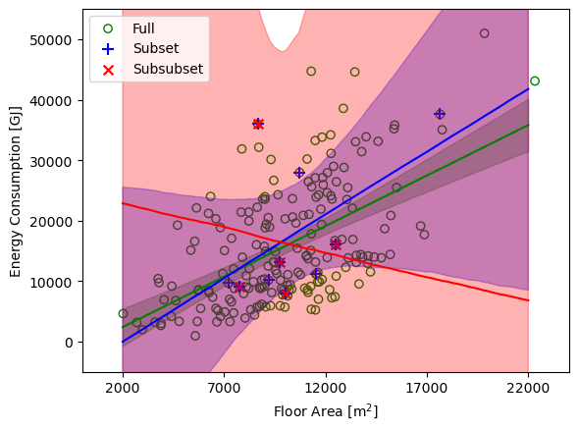
Bayesian Linear Regression
Least Squares (maximum-likelihood)
Bayesian

Slide 16
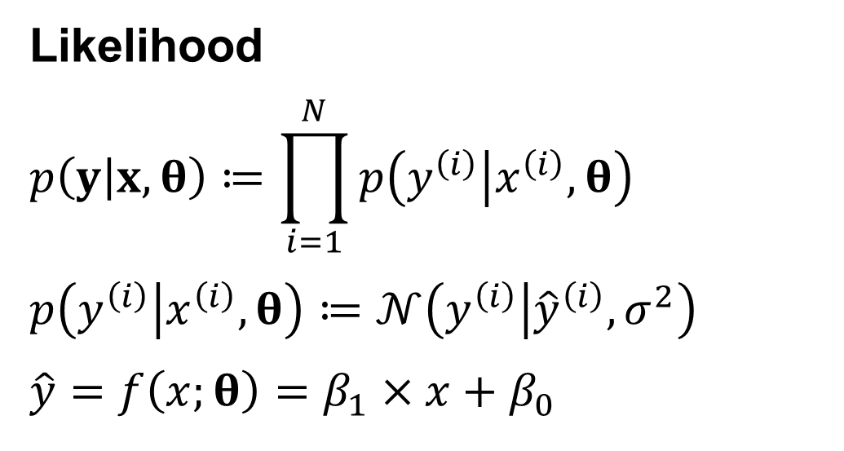
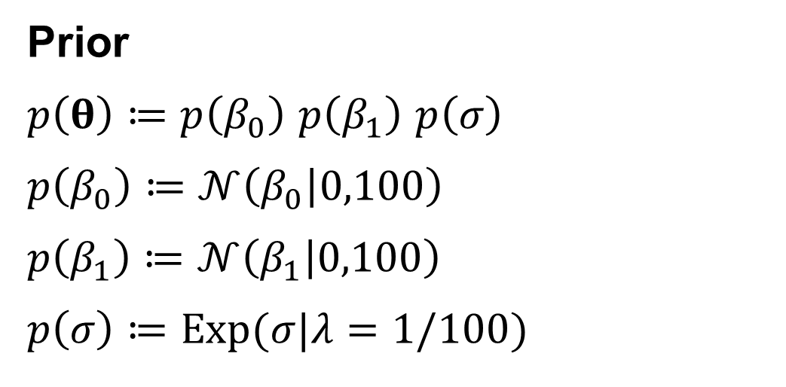
Bayesian Linear Regression
Prior
$p\left(θ\right)≔p\left(β_{0}\right)$ $p\left(β_{1}\right)$ $p\left(σ\right)$
$$p\left(β_{0}\right)≔𝒩\left(β_{0} | 0,100\right)$$
$$p\left(β_{1}\right)≔𝒩\left(β_{1} | 0,100\right)$$
$$p\left(σ\right)≔Exp(σ|λ=1/100)$$
Likelihood
$$p\left(y | x,θ\right)≔\prod_{i=1}^{N}{p\left(y^{\left(i\right)} | x^{\left(i\right)},θ\right)}$$
$$p\left(y^{\left(i\right)} | x^{\left(i\right)},θ\right)≔𝒩\left(y^{\left(i\right)} | {\hat{y}}^{\left(i\right)},σ^{2}\right)$$
$$\hat{y}=f\left(x;θ\right)=β_{1}×x+β_{0}$$

Slide 17
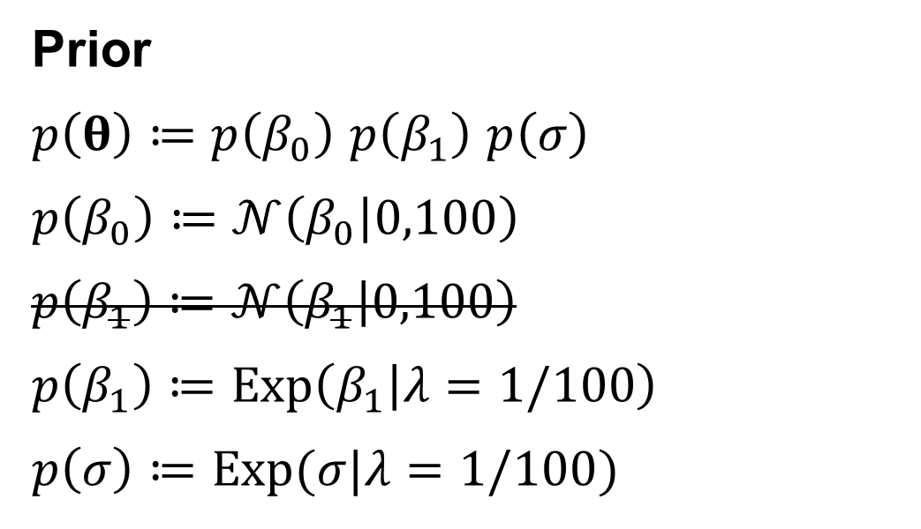
Bayesian Linear Regression
Prior
$p\left(θ\right)≔p\left(β_{0}\right)$ $p\left(β_{1}\right)$ $p\left(σ\right)$
$$p\left(β_{0}\right)≔𝒩\left(β_{0} | 0,100\right)$$
$$p\left(β_{1}\right)≔𝒩\left(β_{1} | 0,100\right)$$
$$p\left(β_{1}\right)≔Exp\left(β_{1} | λ=1/100\right)$$
$$p\left(σ\right)≔Exp(σ|λ=1/100)$$
Likelihood
$$p\left(y | x,θ\right)≔\prod_{i=1}^{N}{p\left(y^{\left(i\right)} | x^{\left(i\right)},θ\right)}$$
$$p\left(y^{\left(i\right)} | x^{\left(i\right)},θ\right)≔𝒩\left(y^{\left(i\right)} | {\hat{y}}^{\left(i\right)},σ^{2}\right)$$
$$\hat{y}=f\left(x;θ\right)=β_{1}×x+β_{0}$$

Slide 18
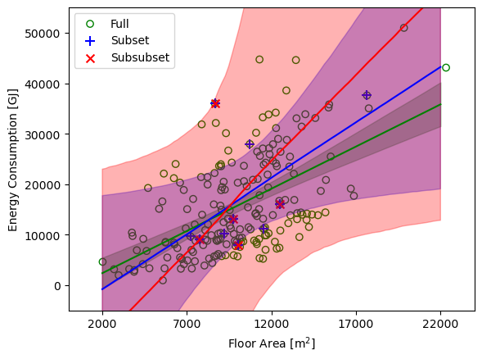
Bayesian Linear Regression
Bayesian
Without informative prior
Bayesian
With informative prior (positive correlation)

Slide 19
Exercise

Slide 20
Thank you
Seungjae Lee
sjae.lee@utoronto.ca

Slide 21
Bayesian Linear Regression
Estimation/Training/Inference Methods
Analytical solution
Sampling (e.g., Markov chain Monte Carlo)
Variational inference

